Slide 1
HEP secondary conference
Working with and supporting each other
A Great Curriculum

Slide 2
Rachel Macfarlane
A teacher since 1989: in Enfield, Barnet, Tower Hamlets, Hertfordshire, Waltham Forest and Redbridge
A Headteacher 2002-2018
Francis Bacon, St Albans: 11-18 mixed secondary (foundation)
Walthamstow School For Girls, Waltham Forest: 11-16 girls’ secondary (LA)
Isaac Newton Academy, Ilford: 4-18 mixed all-through (Ark MAT)
Director of Going For Great (G4G) Programme for LLS 2009-2018
Now Director of Education Services at Herts for Learning (HfL)

Slide 3
Going for Great (G4G)
9 cohorts: 6 secondary, 1 primary, 2 all phase
98 outstanding schools (including Lampton, Gumley House & Heathland)
Exploring the nature of greatness and the features of great schools
9 pillars
168 great practice visits
168 case studies

Slide 4
The Nine Pillars

Slide 5
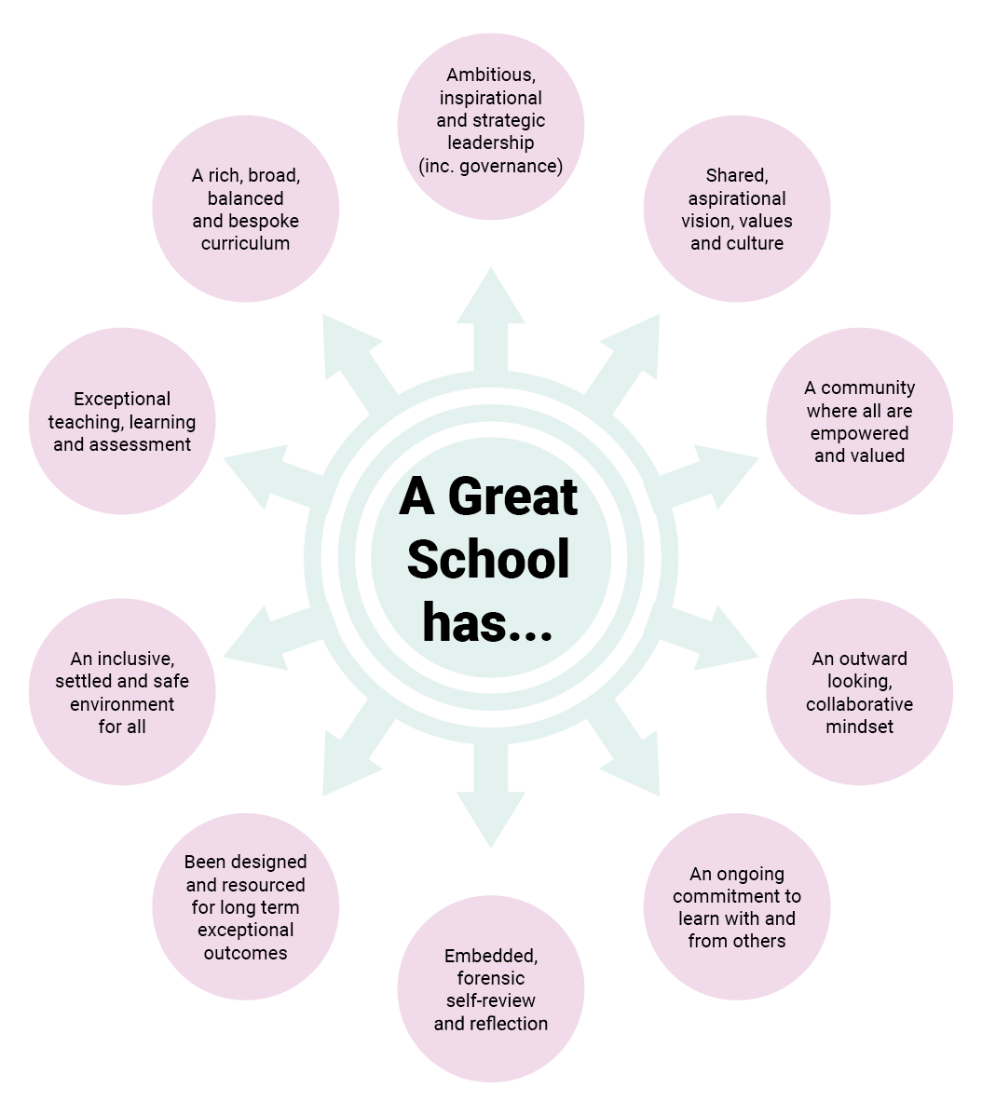
© Herts for Learning 2018

Slide 6
Great Education Partnerships

Slide 7
Interesting Times
A fragmented educational landscape

Slide 8
HEP Secondary Heads’ Group
What does that stand for?

Slide 9
Hounslow Education Partnership Secondary Heads’ Group
What is the thing you appreciate most about being part of the HEP secondary heads’ group?
Identify one thing that a member of HEP secondary heads’ group has done to help or support you.
And one thing you would like the group to do more of/differently to support you.

Slide 10
How do you support each other at your various stages of headship?
New heads
Experienced heads
Exec heads/Trust leaders
Retiring heads

Slide 11
Great Education Partnerships
At HEP we strive to ensure that all children and young people have the best possible opportunities and reach their full learning potential through the collective efforts of our schools.
Our promise is to work with great energy to encourage our members’ shared responsibility, collective moral purpose and vision. We will build on deep and trusted relationships across our supportive, thinking and learning community to deliver excellence in all we do.

Slide 12
The challenge of being collaborative & collegiate

Slide 13
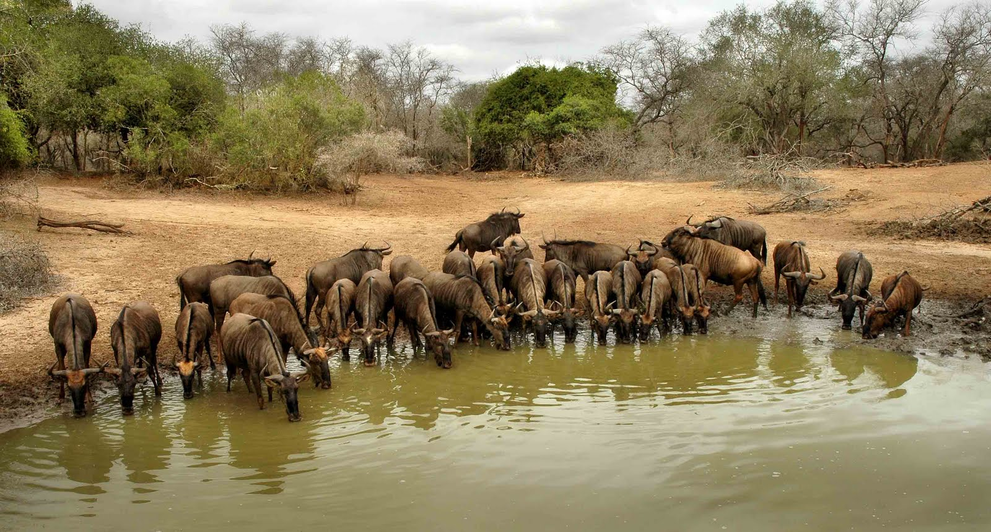
The Watering Hole

Slide 14
The gap between the rhetoric and the reality

Slide 15
“Raising standards, improving lives.”

Slide 16
The challenge of being collaborative & collegiate
Collective moral purpose & vision
Shared responsibility
Deep & trusted relationships
Supportive learning community

Slide 17
Ethical Leadership challenges
How do you hold yourself to account?
How do you hold each other to account?

Slide 18
The challenge of school to school collaboration
“Now we know that building capacity and developing a sense of shared
accountability, trust and the right balance between autonomy and
connectedness is hard in any single organisation, but with insightful
and skilled leadership over time it can be achieved. It is much harder to
achieve this across a group of schools who may be in a competitive
relationship and who may have different cultures and priorities.
The effort involved in effective collaboration means hard-pressed
and time-poor leaders and teachers may not believe
that such commitment is worth it. To do all this in a climate
of strong and often counter-productive top-down national
accountability measures makes it even more daunting.”
Munby & Fullan

Slide 19
Implications of the new framework
Need to be ready for the 90 minute call.
Need a clear curriculum rationale.
Deep dives will require middle leaders to be well prepared: middle leader meetings/discussions will form a more significant part of the inspection than meetings with SLT. Necessity for curriculum vision.
Important that leaders and staff understand the potential limitations of assessment and are sure that staff are not spending too much time on collating, analysing and interpreting data from in-school assessments.
Off-rolling a limiting judgement.
Importance of staff well-being strategies.
Harder to achieve or maintain an outstanding judgement.

Slide 20
How can the HEP secondary heads best support each other to prepare for the new framework?

Slide 21
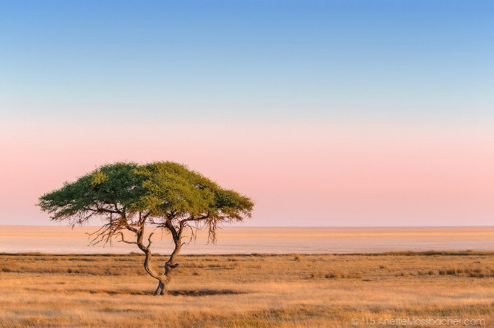
“Kasserian Ingera”
“How goes it
with our children?”
Masai traditional greeting

Slide 22
What makes a great curriculum?
Let’s start with what ‘the curriculum’ is…

Slide 23
One view
‘At the very heart of education sits the vast accumulated wealth of human knowledge and what we choose to impart to the next generation: the curriculum.
Without curriculum, a building full of teachers, leaders and pupils is not a school. Without receiving knowledge, pupils have learned nothing and no progress has been made.’
Amanda Spielman

Slide 24
An alternative view
‘The curriculum is everything that happens to a learner in school. It is not only the subject matter of lessons; it is the whole school experience, including what happens in lunchtime and breaks, extra-curricular activities and school visits.’
John Dunford: The School Leadership Journey (2016)
‘The curriculum is the lived daily experience of young people in and out of the classroom.’
Dylan Wiliam

Slide 25
What is the purpose of education?
Which view (A to F) do you identify with most?

Slide 26
You have c7,000 – 8,000 hours
How are you going to use them?
What experiences are your students going to have?
What is your curriculum vision?
Do you have a whole school curriculum vision?
Does everyone know it?
Strive to live it?
Does each department/faculty have a curriculum vision?
Would everyone in the team know it?

Slide 27
Great schools have a clear curriculum vision
What unites all great schools is an inspirational, aspirational, carefully planned and meticulously crafted curriculum.
Whereas weaker schools may demonstrate curriculum dependency, looking to the government or exam boards to set the framework for what they teach, great schools do not stick slavishly to the national curriculum.
Rather, they are innovative, imaginative, courageous and creative in their approach to designing their own bespoke educational provision.
They have the confidence and capacity to break the mould.

Slide 28
Great schools have a clear curriculum vision
‘The aim of the curriculum of School21 is to develop students who create beautiful work which makes a difference to the world. We want students to leave with all of the knowledge and skills to not only enter the world of work or academia, but also to be equipped to deal with a rapidly changing world. We want them to be ready and able to face the challenges of the world and contribute to making their communities a better place to live. We do this by focusing on the head, heart and hand.’

Slide 29
Why do many schools lack a clear curriculum vision?
SSAT research suggests that curriculum design is one of the least used autonomies of the academies programme, and least important reasons in schools’ decision to convert to academy status.
“Too many teachers and leaders have not been trained to think deeply about what they want their pupils to learn and how they are going to teach it.” Amanda Spielman

Slide 30
What makes a great curriculum?
A great curriculum is…
balanced in its breadth of subjects and topics
rigorous to the disciplines taught
coherent within and across subjects
vertically integrated to promote progress over time
appropriate for the stage of students’ learning
focused in its choice of content
relevant to the young people in the school. D. Wiliam
Do you agree? What else?

Slide 31
What makes a great curriculum?
A great curriculum is…

Slide 32
What makes a great curriculum?
A great curriculum
is based on the highest expectations of all learners
equips students with the knowledge, skills and character necessary for success at university and beyond
fills the knowledge, skills and character gaps of disadvantaged learners
develops the self esteem of learners and promotes a growth mindset
expands horizons and widens the eyes of learners
is bespoke to, but not simply based on their interests of, the cohort
extends well beyond the syllabus
instils a love of and confidence in learning
has demonstrable impact!

Slide 33
The litmus test of a great curriculum?
There is no prototype or exemplar of a great secondary curriculum. There is, however, a water-tight means of testing whether a curriculum is great, and that is through its impact.
If there is evident student enjoyment of learning in all curriculum areas, high levels of interest, concentration, enthusiasm, engagement and progress across a range of subjects and experiences, then the curriculum is great.
Truly great schools inspire their students to develop an all-encompassing love for learning. They focus both on passing on the learning, the values and the beliefs of the past and on developing creative, critical thinkers who have a wide range of skills and aptitudes that they can apply to the world of the future.

Slide 34
© Herts for Learning 2018

Slide 35
A rich, broad, balanced and bespoke curriculum
A great school’s curriculum instils in children a love of learning and supports the acquisition of knowledge and understanding. Its intent is to develop learning skills and to foster positive character traits. It supports the growth of lively, enquiring minds and pupils’ ability to question and argue rationally. Great schools have a clear and bespoke curriculum vision. They are able to meet the needs of the accountability framework whilst being imaginative, brave and creative in their approach to designing their own bespoke educational provision.
The curriculum is designed in a coherent and logically-sequenced fashion - from the desired end point for students in the school backwards - and builds up incrementally from pupils’ starting points. A great curriculum helps pupils to understand the world in which they live, and the interdependence of individuals, groups and nations, enabling them to enter the wider world as active and responsible participants in society. It provides pupils with the opportunity to learn, practise and apply skills that will prepare them for careers in a fast-changing world. Pupils are provided with cultural opportunities beyond their prior experience which widen their horizons: trips, activities, visitors, speakers, fieldwork, extra-curricular sessions and other activities that enhance learning.
A great curriculum provides memorable experiences and rich opportunities for high-quality learning and wider personal development.

Slide 36
Contact me:
Rachel.macfarlane@hertsforlearning.co.uk

